Slide 1
Linked List
A linked list is a data structure consisting of a sequence of elements called nodes, where each node contains a value and a pointer (or reference) to the next node in the sequence.
Types of linked list:
1. Singly Linked List
2. Doubly Linked List
3. Circular Linked List
4. Circular Doubly Linked List

Slide 2
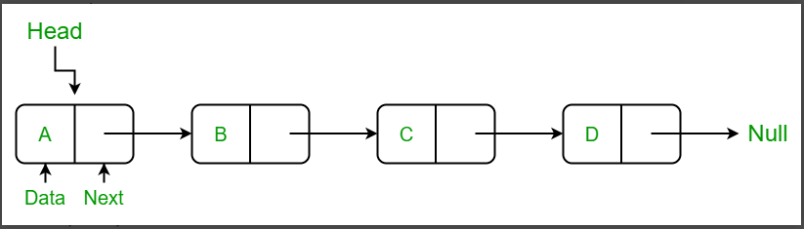
Singly Linked List
Singly Linked List: A singly linked list is a data structure consisting of a sequence of nodes, where each node contains a value and a reference (or pointer) to the next node in the sequence. The first node in the list is called the head, and the last node is called the tail. The tail node's next reference points to null, indicating the end of the list.

Slide 3
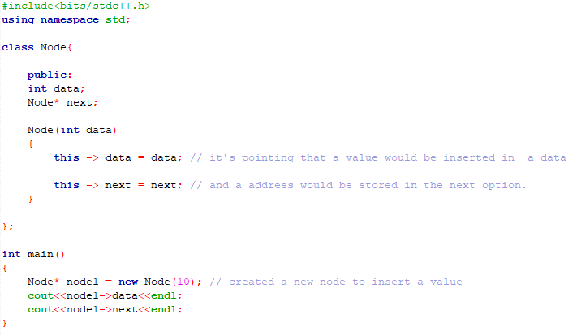
Implement single linked list
Insert the first value and initialize a address associate with them.

